Slide 1
Communications
Manfred Huber
Fall 2019

Slide 2
UxV Communications
UxVs usually require reliable communications for operation
Transmission of data from the UxV
Transmission of commands to the UxV
Communications are important both inside and outside the UxV
Between components on the platform
Will deal with this later
Between multiple UxVs
Between UxVs and ground stations/terminals

Slide 3
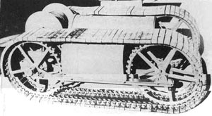
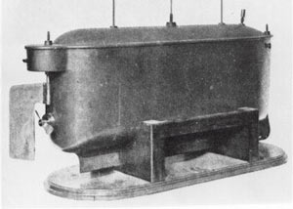
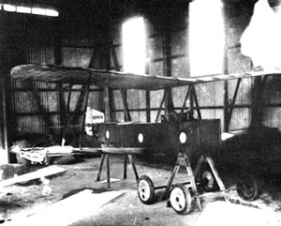
UxV Communications
UxVs communications started at the end of the 19th century
First systems initially used wired communications
Moved to wireless communications early on
First wireless remote control UxV was a boat by Nikola Tesla in 1898
Increasingly more complex use over time

Slide 4
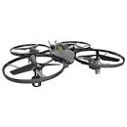

Communication in UxVs
Different forms of UxV systems utilize different communication architectures
One-way remote control platforms
Simple to implement
Very low cost communications
Significant need for human operators
Requires strict line of sight to the platform

Slide 5
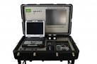
Communication in UxVs
Two-way remote control platforms
Allows operation without line of sight
Higher power requirements on the platform
High bandwidth requirements for return signals
Need for real-time communications
Significant need for human operators
Sensor
Information
Control
Commands

Slide 6

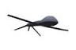

Communication in UxVs
Partially autonomous platforms
Reduced real-time requirements
Reduced operator load
Transmission of selective information
Need for significant processing power and sensor suites on the platform
Status
Information
Control Modes

Slide 7
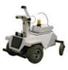
Communication in UxVs
Besides communication to the ground, UxVs also need means of intra-platform communication
Allows to coordinate multiple platforms
Need for significant processing power and sensors on the platform

Slide 8
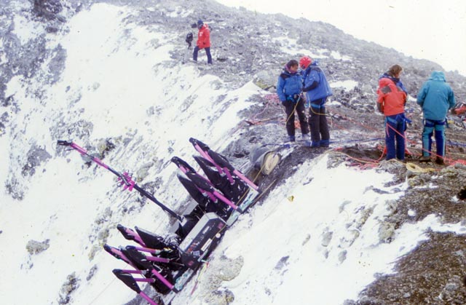

Communication Modalities
Wired communications
Very simple and high throughput
Relatively unaffected by environmental effects
Relatively secure
Severely limits the mobility of the platform

Slide 9
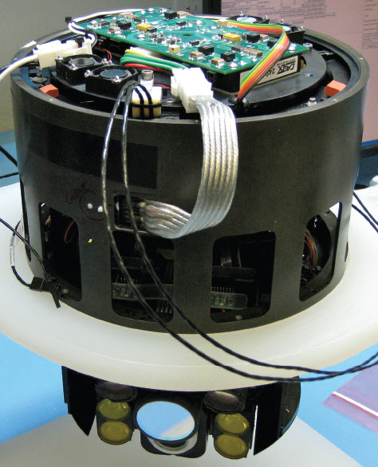
Communication Modalities
Optical Communications
Well focusable to limit interceptability
Works under water for reasonable distances and speeds
Up to 100 Mbps and more than 100m
Requires line of sight

Slide 10
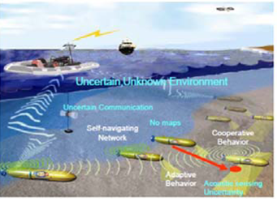

Communication Modalities
Acoustic Communications
Sound can transmit information without need for direct line of sight
Works under water and in air
Sound can travel very large distances in water
Relatively low throughput communications
Easy to intercept and interfere with

Slide 11
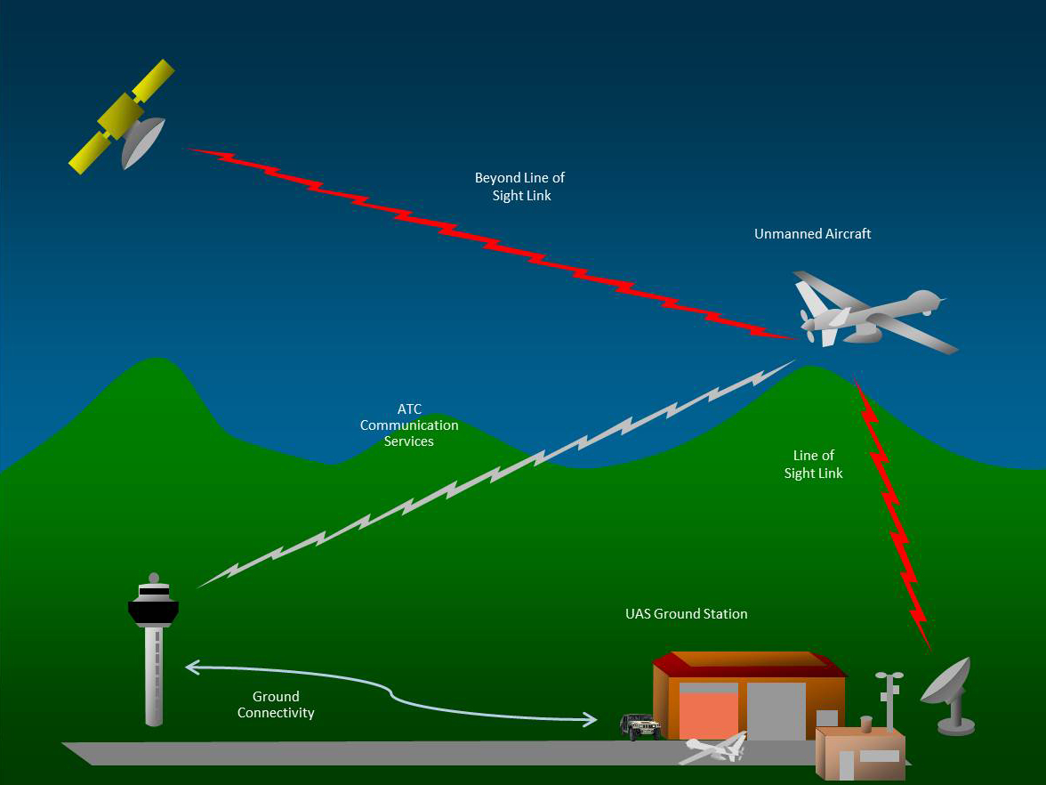
Communication Modalities
Radio Frequency (RF) Communications
Relatively high throughput
Can potentially work without line of sight
Depends on frequency used
Can be focused to reduce interception and to optimize signal loss
Signal quality depends on weather and environment conditions
Does not work under water

Slide 12
RF Communications
RF is the most common communication modality in all UxVs except for submarines
Provides a good balance between cost, range, and data throughput
Can be used omni-directional or in a directed line of sight fashion
Different antenna designs can regulate signal characteristics
Can have different characteristics in terms of signal penetration and range
Choice of RF frequency influences characteristics

Slide 13
RF Communications
As radio frequencies are shared, they are generally regulated and divided in bands
Civil Radio band designation
1-10 kHz VLF (very low frequency)
10-100 kHz LF (low frequency)
100-1000 kHz MF (medium frequency)
1-10 MHz HF (high frequency)
10-100 MHz VHF (very high frequency)
100-1000 MHz UHF (ultra high frequency)
1-10 GHz SHF (super high frequency)
10-100 GHz EHF(extremely high frequency)
US Military, Satellite, and Radar bands
1-2 GHz L Band
2-4 GHz S Band
4-8 GHz C Band
8-12 GHz X Band
12-18 GHz Ku Band
18-27 GHz K Band
27-40 GHz Ka Band
40-75 GHz V Band
75-110 GHz W Band
110-300 GHz mm Band
300-3000 GHz μmm Band

Slide 14
RF Communications
As a general rule of thumb, increasing the RF carrier frequency leads to
Increased throughput
Better ability to focus the signal
Reduced object penetration capabilities
Increased straight line transmission behavior
Reduced atmospheric reflection
Increased sensitivity to weather
There are exceptions based on the specific conditions and properties of the frequencies

Slide 15
RF Communications
In RF communications a signal is modulated onto a carrier frequency
Signal can be analog or digital
Throughput (or achievable data rate) can be influenced through multiple factors
Carrier frequency
Modulation scheme used
Bandwidth (range of frequencies used)
Multiple transmitters

Slide 16
RF Communications
Range can be influenced by a number of measures
Directional transmission
Focuses energy in one direction
High gain antenna design
High sensitivity amplifiers
But: can not overcome real signal interference/noise

Slide 17
RF Communications
Range limitations are driven by signal dissipation and losses
Free space signal loss due to signal dissipation
Atmospheric absorption
Ions in the atmosphere absorb RF energy
Precipitation absorption
Rain and snow absorb RF energy
Signal interference
Natural and artificial phenomena (lightning, solar flares, etc) can produce interference

Slide 18
RF Communications
Choice of the appropriate RF communication scheme for a UxV should consider multiple factors
Available frequency bands and allowed signal strengths
Data rate requirements
Real time requirements
Environmental conditions
Line of sight availability
Interference or jamming risks
Energy availability

Slide 19
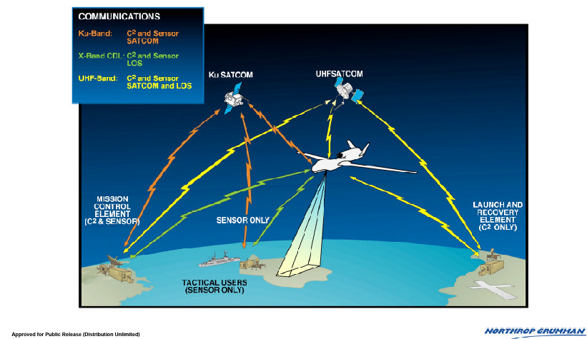
RF Communications
Modern UxVs often use multiple RF communication modes
Commercial Satellite
Military Satellite
Global Hawk example

Slide 20
RF Communication Modes
Omni-directional for station and/or platform
No need for antenna guidance
Potential for signal broadcast
Very fast decrease in signal strength
Directional point to point (line of sight) using parabolic/directional antennas
Relatively large range with limited energy
Reduced risk of interference, interception, and jamming
Need for active antenna tracking

Slide 21
RF Communication Modes
Mixed modes with directional transmit, omni-directional receive or vice versa
Intermediate range
Only partial antenna tracking problem
Relayed communication
Satellite communication
Wider coverage – potentially world-wide
Relay UAV / UGV
Dynamically establishable relays
Smaller overall transmit distance

Slide 22
RF Communication and Mission Requirements
Choice of transmission mode regulates a number of factors
Throughput
Range
Coverage area
Sensitivity to interference, noise, and jamming
Time delay in communications

Slide 23
RF Communication and Mission Requirements
Communication delays impact ability to remotely control UxVs
Line of sight 2ms
Low earth orbit 10ms
Medium earth orbit 100ms
Geostationary 200-300ms
With transmission relays above low earth orbit, direct remote operation of fast vehicles becomes risky
GEA more than triples human reaction time

Slide 24
RF Communication and Mission Requirements
UAVs and UxVs usually have multiple, potentially redundant communication links
E.g. Glowal Hawk:
- UHF (LOS command and control)
- UHF (SatCom command and control)
- CDL (J-band LOS down link)
- SHF (SatCom Ku band down link)
Commercial Satellite
Military Satellite

Slide 25
Wireless Communications
For low-end applications, satellite links and dedicated line of sight communications are often impractical and expensive
Common technologies exist if infrastructure is available or only limited range is required
Cell phone network / WiMax
Limits altitude and excludes certain areas
WLAN
Can be self-deployed
Limits range
Mesh networking
Allows dynamic formation of network
Requires the deployment of relay points

Slide 26
Wireless Networks
Affordable, self-deployable (open) wireless networks and frequencies are available with power limitations
Analog remote control in the 40MHz or 900MHz range
Digital wireless in the 900MHz, 2.4GHz, and 5.2GHz range
Additional services provide infrastructure on leased data channels
Cell phone and WiMax services
Operate at higher power and higher throughput

Slide 27
Wireless Networks
Using wireless media, different types of networks can be established
Point to point networks
Direct communication between two transmitters
Infrastructure-based networks
Communication through an infrastructure access point
Ad-hoc/mesh networks
Communication through other nodes with automatic re-configuration

Slide 28
Wireless Networks
Common standards for wireless systems
802.11 a/b/g/n - WiFi
WiFi provides infrastructure-based communciation (with the possibility for point to point communication)
Relatively high bandwidth and range (<54Mbps , <2km)
High computational and power overhead
Requires consistent communication routes
Easy configuration and use
Most commonly operates on 2.4GHz or 5.2GHz

Slide 29
Wireless Networks
802.15.1 – Bluetooth
Point to point communication
Reasonable data rate (<24Mbps)
Shorter range (<150m)
Very low power requirements
Generally no relay capabilities
Easy configuration and use
Most commonly operates on 2.4GHz

Slide 30
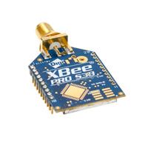
Wireless Networks
802.15.4 – Mesh Networking (e.g. ZigBee)
Mesh Networking
Lower data rate (<250Kbps)
Longer range: high power (<8km); low power (<100m)
Very low power requirements
Dynamic network formation and package re-routing
Built-in relaying
Easy configuration and use
Most commonly operates on 2.4GHz or 900MHz

Slide 31
Wireless Networks
802.16 – WiMax
Long range infrastructure based networking
High data rate (<70Mbps)
Large range (<50km)
Higher power requirements
Requires established infrastructure
Operates in a wide range of spectrums from 500MHz over 2.5GHz to 3.3GHz and 3.5GHz. Most commonly operates on 2.4GHz

Slide 32
Wireless Networks
Point to point vs. Network
Point to point communications usually take the form of wireless serial lines
Single stream of data in each direction
Usually lower overhead and delay times
Higher data rates
Networks allow more than two entities (processes or platforms) to communicate
Arbitrary data streams can be initiated
Multiple data streams can overlap

Slide 33
Wireless Networks
Infrastructure vs. Mesh Networks
Mesh networks provide extra flexibility by allowing to establish the network infrastructure dynamically
Usable in disaster scenarios
Usable in areas without established infrastructure
Mesh networks have a higher overhead for transmitting packets due to route establishment
Lower throughput
Longer packet delay and round trip times
More complex to initially configure
The scenario and environment usually determines what is better

Slide 34
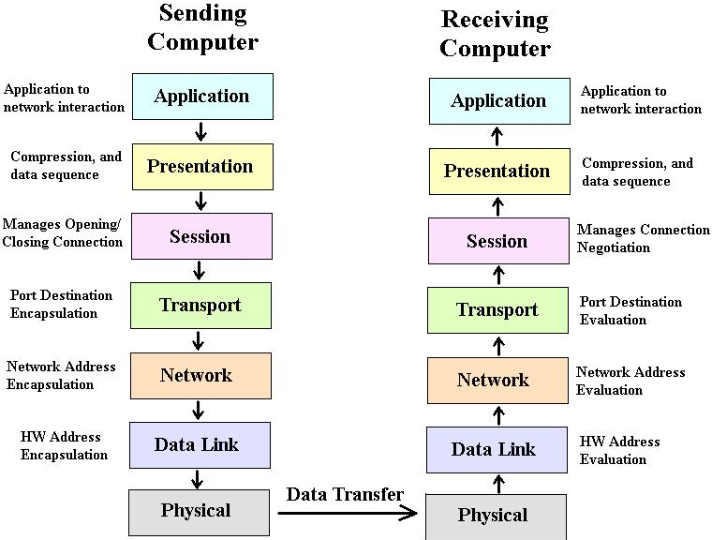
Wireless Networks
Networks and network protocols are structured in multiple layers

Slide 35
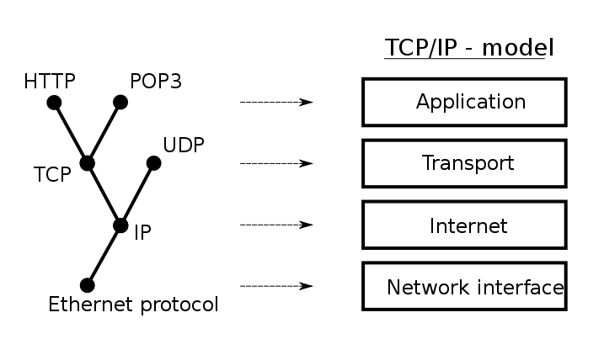
Protocols
Protocols manage data transfer standards
Ensure that transmitter and receiver understand each other
Protocols are layered according to the network layers

Slide 36
Protocols
Link layer protocols handle hardware addresses
Mostly using Media Access Control (MAC) addresses
Network layer protocols handle addressing
Most commonly using Internet Protocol (IP) addressing
Transport layer protocols handle data transfer
Transmission Control Protocol (TCP) for reliable, ordered, error-checked data transfer
User Datagram Protocol (UDP) for transfer without handshakes

Slide 37
Transport Layer Protocols
TCP and UDP are the most common internet transport protocols
TCP provides reliable connections
Handshaking, Collision checking, Error detection, Packet ordering
Requires to re-transmit packets if transfer medium is unreliable (e.g. wireless signals)
UDP operates on best effort basis
Data is transmitted but transmission is not verified
Packets are not ordered or error checked
Provides mechanisms for checksums

Slide 38
Transport Layer Protocols
In an unreliable medium such as wireless, the choice of protocol is important
TCP provides guarantees but has pretty significant overhead
Bandwidth use can be significantly higher than actual data transfer
Re-transmissions of very large packages can bog down network due to significant chance of errors
Back-off from collisions delays data transmission
UDP is useful if some data loss is acceptable or if data has to be real-time
Data is transmitted at a given rate

Slide 39
Internet Protocols
The most common suite of protocols is the Internet Protocol suite
IP protocols treat all traffic the same
Traditionally no priorities
No timing or ordering guarantees at the link layer
Real time protocols are implemented in top of UDP
No true real time guarantees
Priorities have been added to the network protocols but are not commonly used
Priorities can be useful for UxV communication

Slide 40
Application Protocols
Users interact with application layer protocols
Application layer protocols define specific application components
File transfer protocols (e.g. ftp, sftp, ftps)
Remote session protocols (e.g. telnet, ssh, rfb)
Data streaming protocols (e.g. rtsp)
Hypertext protocols (e.g. http)
Application layer protocols are selected according to the needs of the application
Timing requirements
Reliability requirements
Data transfer requirements

Slide 41
Wireless Security
Wireless transmission are usually prone to noise, interference, and jamming
Wired and optical communications are usually harder to jam than acoustic and RF
Directional line of sight transmissions are harder to jam than omni-directional transmissions
Wireless transmissions are generally interceptable
Others can listen in
Transmission content can be altered
Transmissions can be spoofed

Slide 42
Wireless Security
Multiple means can be taken to make communications more secure
Physical means:
Directional communications
Use of difficult to operate in medium
Error correction
Error checking and error correcting codes can be used to identify transmission errors
Encryption and authentication
Encryption of the link and of the data protects against falsification of content
Authentication protects against spoofing

Slide 43
Wireless Security
Wireless networks use different types of encryption
Network level authentication and encryption
Authenticates clients and encrypts all network traffic
Only authenticating clients can transmit and read/write packets
E.g. Wired Equivalent Privacy (WEP) or WiFi Protected Access (WPA)
Connection level authentication and encryption
Authenticates/encrypts when establishing a particular connection
E.g. Secure Sockets Layer (SSL)

Slide 44
Wireless Security
Encrypted connections protect against interception as well as the willful injection of data
No protection from jamming
No protection against data loss
Encryption introduces computational overhead
Encryption and decryption require additional computation
Encryption and decryption slightly increase communication delays

Slide 45
UxV Networking
A wide range of networking mechanisms exist for use in UxVs
Network structure based on task needs
Range requirements
Number of UxVs
Type of data to be exchanged
Data loss implications
Infrastructure or mesh networks can support mixed protocol types
Use of overlapping protocol types influence each others performance
E.g. UDP traffic delays TCP traffic

Slide 46
UxV Communications
UxVs can use a wide range of communication mechanisms
Different communication media
Various network structures
Different communication protocols
Platform and task characteristics should inform choice of communication setup
Environment influences best communication medium and mechanism
Task requirements determine network and protocol choices

